Slide 1
Causes of the Civil War
1. Slavery
2. Uncle Tom's Cabin
3. Raid on Harper's Ferry
4. Election of Abraham Lincoln
5. States' Rights

Slide 2
Confederate States of America

Slide 3
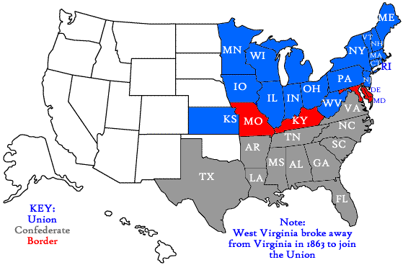
Union States during the Civil War
California
Connecticut
Illinois
Indiana
Iowa
Kansas
Maine
Massachusetts
Michigan
Minnesota
Nevada
New Hampshire
New Jersey
New York
Ohio
Oregon
Pennsylvania
Rhode Island
Vermont
Wisconsin

Slide 4
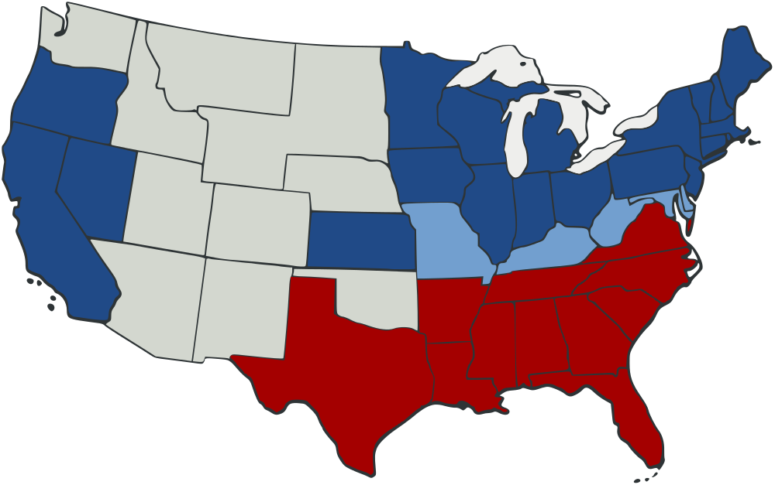
The Union
Many more factories, people, & railroads
Huge advantage in weapons & military
Stronger political structure
The Confederacy
Brilliant military commanders
Battles fought mostly on their land
Great desire for victory

Slide 5
Directions: Create 4 rows in your notebook. Title them like mine!
Missouri Compromise
Compromise of 1850
Kansas-Nebraska Act
Dred Scott Decision

Slide 6
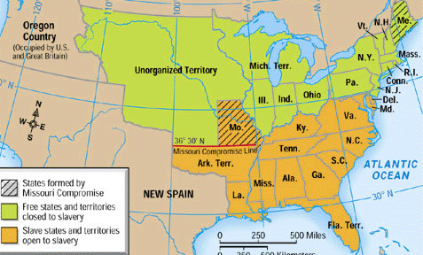
Missouri Compromise
Missouri – Union – slave
Maine – Union - free
divided Louisiana Territory into two areas, one north (free) and one south (slave)

Slide 7
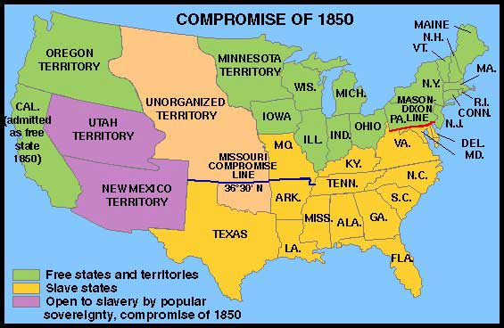
Compromise of 1850
California – free state
Utah - choice
New Mexico - choice

Slide 8
Kansas-Nebraska Act (1854)
Cancelled the Missouri Compromise (made northerners mad!)
Said slavery could exist if voters voted for it (popular sovereignty)
Created:
Kansas
Bleeding Kansas- fighting occurred over the decision
Nebraska

Slide 9
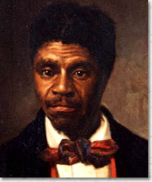
Dred Scott Decision
went with his master to Illinois and claimed he was free because he was in a free state
Missouri court said NO!!
Scott sued
Court said African Americans aren’t citizens

